Slide 1
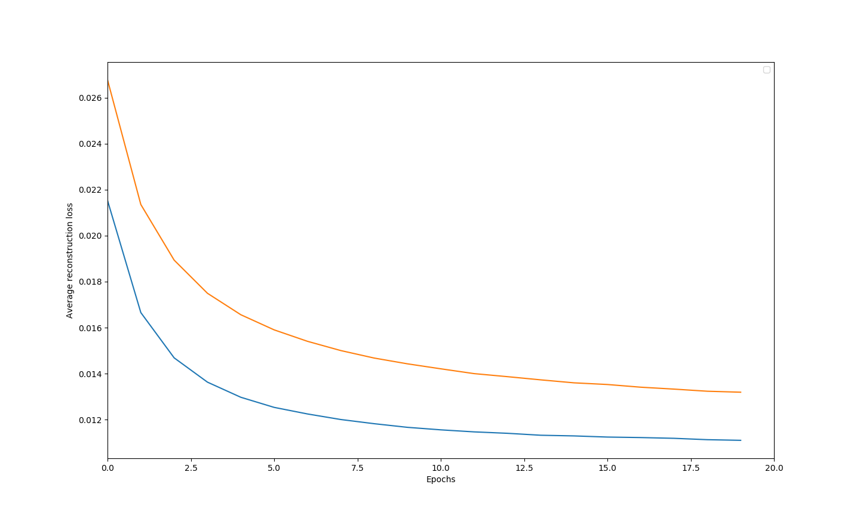
Average reconstruction loss
Average reconstruction loss: n_hidden = 500 (blue), n_hidden = 200 (orange).
Decreasing the number of hidden units increases the average reconstruction loss.

Slide 2
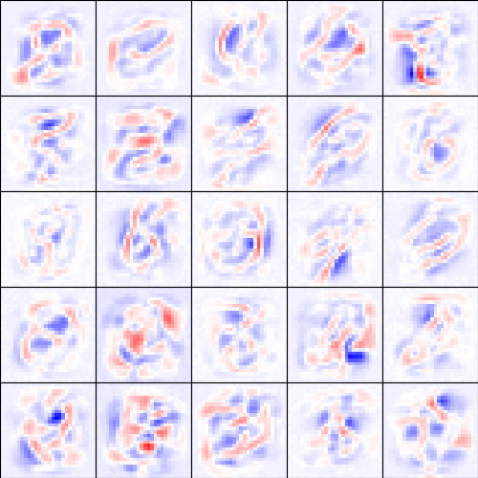
Receptive fields
The receptive field is like a mixture of some numbers.
Receptive fields (15 epochs, n_hidden = 500)

